Slide 1

Growing As Children of Light
Notes:
This graphic came from Jason Hardin. I am certain have I have used notes from Mark Copeland’s EO series, Randy Yerby, Aaron Fleenor and other in making these powerpoints. Further, images have been used from the internet that remain property of their owners. This can not be sold or used commercially. It can only be used for classroom (Bible class) purposes.

Slide 2
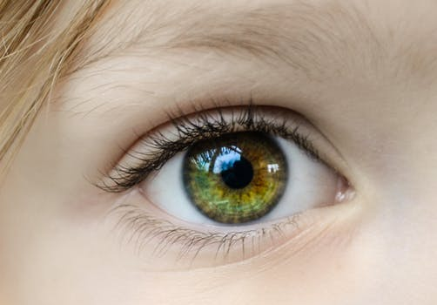

Eyeing Second Peter
Building On God’s Promises
Escaping the Corruption in the World
Partaking of the Divine Nature
Week 9: Brotherly Kindness

Slide 3

Eyeing Second Peter
Weekly study plan:
Read 2 Peter once a week
Work on the memory verse by reading it carefully aloud at least eleven times this week
Any study on next weeks topic in the text from next week’s topic: LOVE

Slide 4
Memory Passage: 2 Peter 1:3-4
According as his divine power hath given unto us all things that pertain unto life and godliness,
through the knowledge of him that hath called us to glory and virtue:
Whereby are given unto us exceeding great and precious promises:
that by these ye might be partakers of the divine nature,
having escaped the corruption that is in the world through lust.

Slide 5
Remembering Second Peter
Blindness and Myopia Control
Eyes Full of Adultery
Twinkling of an Eye
Holiness – Heresy – Hope
Cultivate Christian Character
Condemnation of false teachers
Confidence in Christ’s return
Read 10X, 10 Classes, Mechanism, Memory verse

Slide 6
Introduction: Myopia and Blindness Control
Growing in the knowledge of Jesus Christ requires developing a Christ-like character, partaking of the divine nature (holiness).
This requires all diligence to develop seven “graces”, in our lives, in conjunction with each other.
2 Peter 1:5-10 ⁵ And beside this, giving all diligence, add to your faith virtue; and to virtue knowledge;⁶ And to knowledge temperance; and to temperance patience; and to patience godliness;⁷ And to godliness brotherly kindness; and to brotherly kindness charity.⁸ For if these things be in you, and abound, they make you that ye shall neither be barren nor unfruitful in the knowledge of our Lord Jesus Christ.⁹ But he that lacketh these things is blind, and cannot see afar off, and hath forgotten that he was purged from his old sins.¹⁰ Wherefore the rather, brethren, give diligence to make your calling and election sure: for if ye do these things, ye shall never fall:

Slide 7
Introduction – Myopia and Blindness Control
Overview of 2 Peter and graces (Myopia Control)
Escaping corruption in the world through lust
Diligence
Build on “faith”.
Virtue or moral excellence
Knowledge
Self-Control
Patience
Godliness
“add” – epichoregeo
Brotherly Kindness

Slide 8
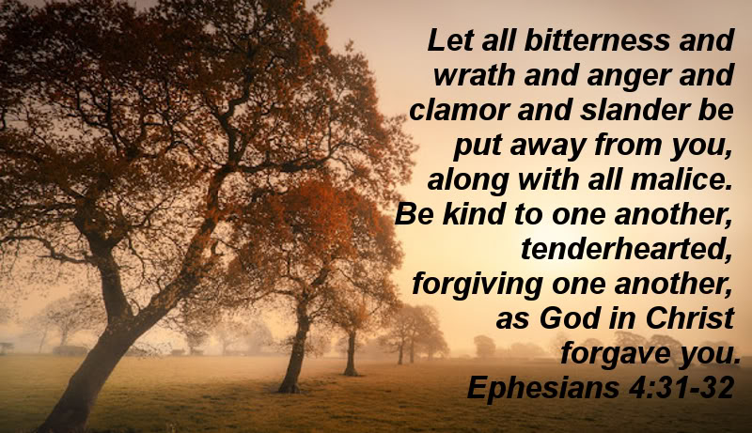
Kindness
2 Peter 1:5-11

Slide 9
Define “Kindness”
A note about Greek and Hebrew words

Slide 10

Proverbs 3:3-4
Let not kindness (mercy) and truth forsake you; Bind them around your neck, Write them on the tablet of your heart, 4And so find favor and high esteem In the sight of God and man.

Slide 11

Kindness (Mercy) Defined
Kindness or mercy, if one is using the KJV, comes from Strong’s word 2617.
It is most often translated as mercy, but is also translated as kindness, lovingkindness, goodness, kindly, merciful, and favor.
Kindness is difficult to define, yet a more significant matter of the law
Sometimes it means friendly or generous or understanding or tolerant or benevolent.
Kindness is best defined by recognizing it when demonstrated.

Slide 12
Kindness (Mercy) Defined
Hebrew: “chesed” – literally means, “to treat courteously and appropriately,” it is also translated, “loving-kindness”.
Greek: “cherestotes” – literally means “useful, pleasant, gracious”.
Put them together: Kindness is “caring enough about others that we treat them with gentleness, graciousness and generosity.”

Slide 13
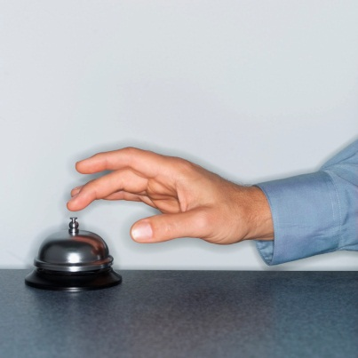
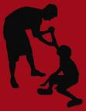
Kindness (Mercy) Defined
Kindness is an action. It provides what is useful, helpful, and of service.
One can easily recognize kindness when they see it.
Kindness acts to provide for the needs of others, often who cannot provide for themselves.
It is concerned for others.
It does not act out of selfishness, greed, or covetousness.
It is a fruit of the Spirit (Galatians 5:22).
It is universally translated without language.
For the one who demonstrates kindness, it can come with risk and expense

Slide 14
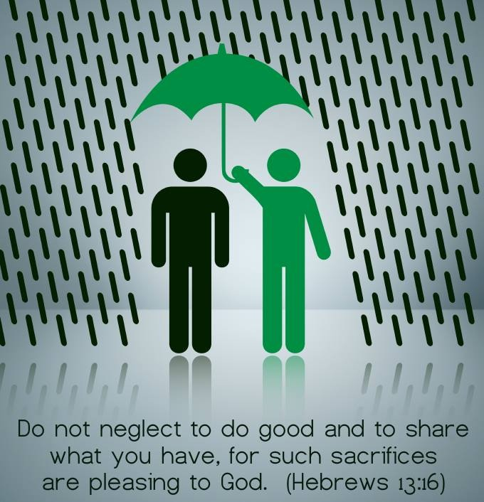

Slide 15

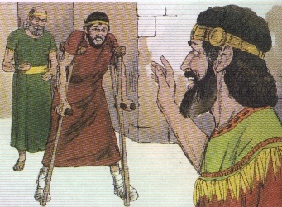
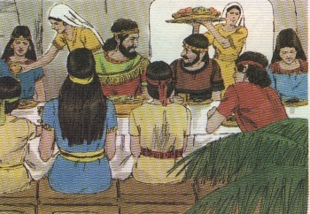
Demonstrations of Kindness
Consider David and his attitude toward Mephibosheth in 2 Samuel 4:4 and 9:1-13. What might have Mephibosheth expected? Why was David kind to him? How did David demonstrate kindness?
Notes:
The first time I heard this series of examples used together was from Dwight Mullet. Further, I recall using notes that I took when he preached on kindness that made their way into this powerpoint.

Slide 16
Demonstrations of Kindness: David and Mephibosheth
4:4 And Jonathan, Saul's son, had a son that was lame of his feet. He was five years old when the tidings came of Saul and Jonathan out of Jezreel, and his nurse took him up, and fled: and it came to pass, as she made haste to flee, that he fell, and became lame. And his name was Mephibosheth.

Slide 17
Demonstrations of Kindness: David and Mephibosheth
9:1 And David said, Is there yet any that is left of the house of Saul, that I may show him kindness for Jonathan's sake?
9:2 And there was of the house of Saul a servant whose name was Ziba. And when they had called him unto David, the king said unto him, Art thou Ziba? And he said, Thy servant is he.
9:3 And the king said, Is there not yet any of the house of Saul, that I may show the kindness of God unto him? And Ziba said unto the king, Jonathan hath yet a son, which is lame on his feet.
9:4 And the king said unto him, Where is he? And Ziba said unto the king, Behold, he is in the house of Machir, the son of Ammiel, in Lodebar.
9:5 Then king David sent, and fetched him out of the house of Machir, the son of Ammiel, from Lodebar.
9:6 Now when Mephibosheth, the son of Jonathan, the son of Saul, was come unto David, he fell on his face, and did reverence. And David said, Mephibosheth. And he answered, Behold thy servant! (Here is thy servant)
9:7 And David said unto him, Fear not: for I will surely show thee kindness for Jonathan thy father's sake, and will restore thee all the land of Saul thy father; and thou shalt eat bread at my table continually.

Slide 18
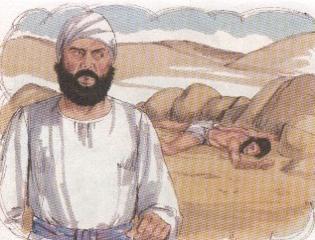
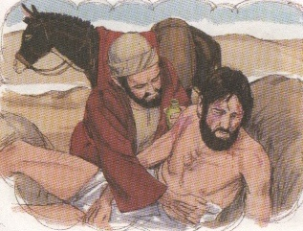
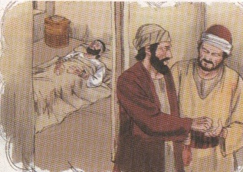
Demonstrations of Kindness
In Luke 10:29-37, the good Samaritan demonstrates kindness to the man who was robbed? Why was this unexpected? What did the priest and Levite demonstrate? What did the Samaritan provide to the man?
unselfish kindness serviceable, at no small risk,
at no small expense to himself.
more interested in themselves

Slide 19
Demonstrations of Kindness: Good Samaritan
10:29 But he, willing to justify himself, said unto Jesus, And who is my neighbour?
10:30 And Jesus answering said, A certain man went down from Jerusalem to Jericho, and fell among thieves, which stripped him of his raiment, and wounded him, and departed, leaving him half dead.
10:31 And by chance there came down a certain priest that way: and when he saw him, he passed by on the other side.
10:32 And likewise a Levite, when he was at the place, came and looked on him, and passed by on the other side.
10:33 But a certain Samaritan, as he journeyed, came where he was: and when he saw him, he had compassion on him,
10:34 And went to him, and bound up his wounds, pouring in oil and wine, and set him on his own beast, and brought him to an inn, and took care of him.
10:35 And on the morrow when he departed, he took out two pence, and gave them to the host, and said unto him, Take care of him; and whatsoever thou spendest more, when I come again, I will repay thee.
10:36 Which now of these three, thinkest thou, was neighbour unto him that fell among the thieves?
10:37 And he said, He that shewed mercy on him. Then said Jesus unto him, Go, and do thou likewise.

Slide 20
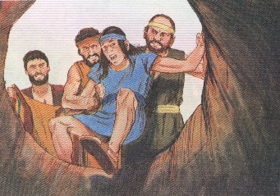
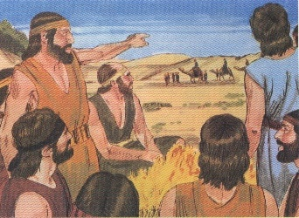
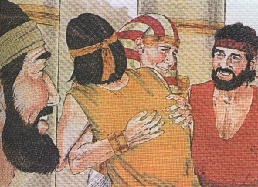
Examples of Kindness
How did Joseph demonstrate kindness to his brothers in Genesis 50:15-21? What did they expect because of how they had treated him?

Slide 21
Demonstrations of Kindness: Joseph and His Brothers
50:15 And when Joseph's brethren saw that their father was dead, they said, Joseph will peradventure hate us, and will certainly requite us all the evil which we did unto him.
50:16 And they sent a messenger unto Joseph, saying, Thy father did command before he died, saying,
50:17 So shall ye say unto Joseph, Forgive, I pray thee now, the trespass of thy brethren, and their sin; for they did unto thee evil: and now, we pray thee, forgive the trespass of the servants of the God of thy father. And Joseph wept when they spake unto him.
50:18 And his brethren also went and fell down before his face; and they said, Behold, we be thy servants.
50:19 And Joseph said unto them, Fear not: for am I in the place of God?
50:20 But as for you, ye thought evil against me; but God meant it unto good, to bring to pass, as it is this day, to save much people alive.
50:21 Now therefore fear ye not: I will nourish you, and your little ones. And he comforted them, and spake kindly unto them.

Slide 22
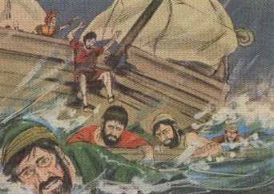
Demonstrations of Kindness
What actions did the people of Melita show to Paul after the ship wreck in Acts 27:41-28:2?

Slide 23
Demonstrations of Kindness: Paul and the People of Melita
27:41 And falling into a place where two seas met, they ran the ship aground; and the forepart stuck fast, and remained unmoveable, but the hinder part was broken with the violence of the waves.
27:42 And the soldiers' counsel was to kill the prisoners, lest any of them should swim out, and escape.
27:43 But the centurion, willing to save Paul, kept them from their purpose; and commanded that they which could swim should cast themselves first into the sea, and get to land:
27:44 And the rest, some on boards, and some on broken pieces of the ship. And so it came to pass, that they escaped all safe to land.
28:1 And when they were escaped, then they knew that the island was called Melita
28:2 And the barbarous people shewed us no little kindness: for they kindled a fire, and received us every one, because of the present rain, and because of the cold.

Slide 24
What kind of risk or expense can come with kindness?

Slide 25
Demonstrations of Kindness: Risk/Danger
What kind of risk or expense can come with kindness?
Eg Good Samaritan
For some in this world, kindness can be seen as weakness .
Sometimes the person who does kindness is singled out for ridicule.
We need to remember that for Christians, the reward may not be immediate and will come later. God is keeping record.
There is risk in Kindness…but there was risk when God exercised kindness in sending his son
When God sent His Son into the world some appreciated it, some did not.

Slide 26
Kindness Demonstrated by God
How does God uses kindness to lead people to repentance?
Is kindness part of the Divine nature?
How does kindness convert where nothing else ?
What example of God’s kindness can Christians imitate?

Slide 27

Kindness Demonstrated by God Worthy of Emulating
God uses kindness to lead people to repentance.
Christians represent the kind nature of God to the world when they are kind. Such reflection demonstrates that they have partaken of the Divine nature.
Romans 2:4 explains, “Or do you despise the riches of His goodness, forbearance, and longsuffering, not knowing that the goodness of God leads you to repentance?”
Kindness teaches and converts where nothing else will – it can move the most stubborn of hearts.
Notice how the Lord has demonstrated mercy and kindness to his people.
Joel 2:13-14 reminds as the Lord’s locust army marched, “So rend your heart, and not your garments; Return to the Lord your God, For He is gracious and merciful, Slow to anger, and of great kindness; And He relents from doing harm. 14Who knows if He will turn and relent, And leave a blessing behind Him—A grain offering and a drink offering For the Lord your God?”
God demonstrated love toward all who were dead in trespass that he might demonstrate the greatness of His kindness in Christ.

Slide 28
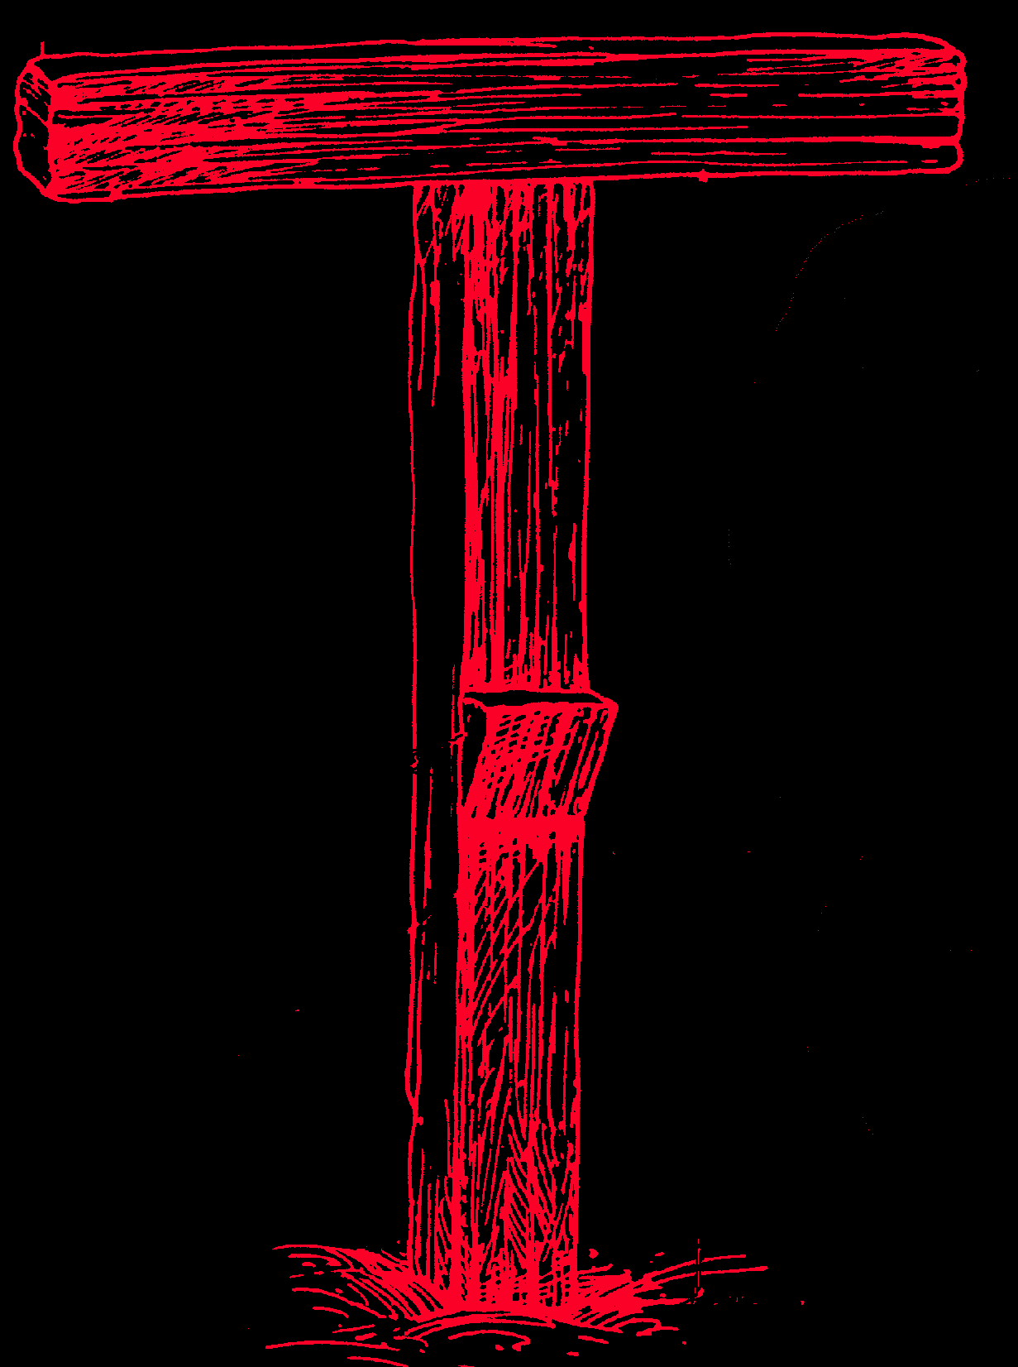
Kindness Demonstrated by God Worthy of Emulating
Paul explains in Ephesians 2:4-10: “But God, who is rich in mercy, because of His great love with which He loved us, 5even when we were dead in trespasses, made us alive together with Christ (by grace you have been saved), 6and raised us up together, and made us sit together in the heavenly places in Christ Jesus, 7that in the ages to come He might show the exceeding riches of His grace in His kindness toward us in Christ Jesus. 8For by grace you have been saved through faith, and that not of yourselves; it is the gift of God, 9not of works, lest anyone should boast. 10For we are His workmanship, created in Christ Jesus for good works, which God prepared beforehand that we should walk in them.”
Notice how God took action to demonstrate His kindness toward humankind.
Titus 3:4-7 teaches: “But when the kindness and the love of God our Savior toward man appeared, 5not by works of righteousness which we have done, but according to His mercy He saved us, through the washing of regeneration and renewing of the Holy Spirit, 6whom He poured out on us abundantly through Jesus Christ our Savior, 7that having been justified by His grace we should become heirs according to the hope of eternal life.”

Slide 29
Kindness Demonstrated by God Worthy of Emulating
God has committed all to disobedience that He might have mercy on all (Romans 11:29-33), demonstrating His kindness with cheerfulness (Romans 12:8).
The Christian must always be mindful of the kindness and love that they have received from God and reflect that kindness and love in their lives.
Through the Lord’s abundant kindness and mercy, the Christian has a living hope through the resurrection of Jesus Christ from the dead and an incorruptible inheritance (1 Peter 1:3-5).
The Christian must always be mindful of God’s mercy toward them.(1 Peter 2:9-10)
Too often it seems that members of the church are exacting about the letter of the law, but miss the weightier matter of mercy (kindness).
"Because Thy loving-kindness is better than life, my lips shall praise Thee" Psalm 63:3

Slide 30
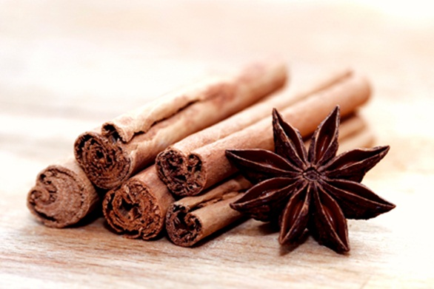
Kindness Demonstrated by God Worthy of Emulating
In Matthew 23:23-25, Jesus taught, “Woe to you, scribes and Pharisees, hypocrites! For you pay tithe of mint and anise and cummin, and have neglected the weightier matters of the law: justice and mercy and faith. These you ought to have done, without leaving the others undone. 24“Blind guides, who strain out a gnat and swallow a camel! 25“Woe to you, scribes and Pharisees, hypocrites! For you cleanse the outside of the cup and dish, but inside they are full of extortion and self-indulgence.” See also Matthew9:12-13.
James 2:13 helps one understand, “13For judgment is without mercy to the one who has shown no mercy. Mercy triumphs over judgment.”
Kindness is God’s tool to teach and convert.
It is emulated in His people.
Kindness is commanded of the Christian.
It allows one to represent the nature of God to the world. It attracts people to the message of the gospel, leading to repentance.

Slide 31
How does one develop kindness?

Slide 32
Developing Kindness: Human Observation
“Kindness is too often left uncultivated, because men do not sufficiently understand its value. Men may be charitable and not kind; merciful, yet not kind; self-denying and yet not kind. If they would add a little common kindness to their uncommon graces, they would convert ten where they now only abate the prejudice of one.”
Frederick W. Faber

Slide 33
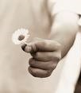
Developing Kindness
How does one develop kindness?
Consider that kindness is best demonstrated in action.
It is visiting a lonely person or giving encouragement to one in time of difficulty. It is helping a classmate in need of teaching or defense when attacked.
It provides for some other person’s need in service.
In reflection, most can find times when they have been unkind because impatience or temper.
Christians nurture the fruits of the Spirit by applying and exercising God’s word in their life.
Galatians 5:22 teaches: “22But the fruit of the Spirit is love, joy, peace, longsuffering, kindness, goodness, faithfulness, 23gentleness, self-control. Against such there is no law. 24And those who are Christ’s have crucified the flesh with its passions and desires. 25If we live in the Spirit, let us also walk in the Spirit.”

Slide 34
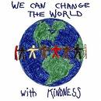
Developing Kindness
Further, one demonstrates kindness because it is commanded.
Colossians 3:12-13 teaches, “12Therefore, as the elect of God, holy and beloved, put on tender mercies, kindness, humility, meekness, longsuffering; 13bearing with one another, and forgiving one another, if anyone has a complaint against another; even as Christ forgave you, so you also must do.”
The child of God must nurture this characteristic in leading a godly life.
Paul uses “by kindness” as one way they would be recommended as ministers of God in 2 Corinthians 6:6.
In 2 Peter 1:6 and following, brotherly kindness is something that the Christian adds to their life in supplying their entrance into the everlasting kingdom (See 1 Peter 1:5-11).
God wants His children to develop kindness in their lives.
Kindness should be practiced without expecting in return.

Slide 35
How can we develop greater kindness?
Remember the kindness of God toward us.
Repent of any callousness we have shown in the past.
Record the names of specific people in need to whom we can:
Be more gentle
Be more gracious
Be more generous
Kindness can transform people – Luke 19:1-10
Kindness preaches – loud, clear and powerful
“The milk of human kindness should be brought fresh to the table every morning.”
Austin O’Malley

Slide 36

Developing Kindness
The Christian is motivated out of the kindness that Jesus demonstrated in purchasing their salvation at such great expense to Himself.
The Psalmist expressed it this way in 117:2, “For His merciful kindness is great toward us, And the truth of the Lord endures forever. Praise the Lord!”
The contrast of kindness to one’s own unkindness and sin motivates a change.
Proverbs 16:6 explains, “In mercy and truth Atonement is provided for iniquity; And by the fear of the Lord one departs from evil.”
If one hopes for God’s mercy one must be merciful. (See Matthew 5:7)
Clearly, the Lord desires mercy and kindness.
Proverbs 19:22 teaches, “What is desired in a man is kindness, And a poor man is better than a liar.”

Slide 37
What Are Some Potential Negatives of Kindness the Christian May Face?

Slide 38
Potential Negatives of Kindness the Christian May Face
Sometimes, kindness does not always seem pleasant to the recipient.
Psalm 141:5 remarks, “Let the righteous strike me; It shall be a kindness. And let him rebuke me; It shall be as excellent oil; Let my head not refuse it. For still my prayer is against the deeds of the wicked.”
A good friend smacks their friend when needed.
An old (reputedly) Russian story can illustrate.
Not everyone appreciates the Lord’s sacrifice at Calvary. Others did.
Not everyone will appreciate the kindness of Christians.
Notes:
The Russian snowbird story: Bird flying to get to barn in distance. Falls frozen to ground a few hundred feet away. Facing death, it is rescued by a cow who poops on it passing by. The heat allows the bird to warm up enough to get into the barn. In the barn as it is cleaning up, a cat comes along to help the bird clean itself. Then the cat eats the bird. Not everyone who dumps on you is your enemy.

Slide 39
Potential Negatives of Kindness the Christian May Face
In fact, they may abuse the person because they perceive the action as a weakness.
Christians must be mindful that the reward for kindness may not be immediate, but God knows.
Romans 12:19-21 explains: “91Beloved, do not avenge yourselves, but rather give place to wrath; for it is written, “Vengeance is Mine, I will repay,” says the Lord. 20Therefore “If your enemy is hungry, feed him; If he is thirsty, give him a drink; For in so doing you will heap coals of fire on his head.”21Do not be overcome by evil, but overcome evil with good.” (Here Paul quotes Proverbs 25:21-22)
Similarly, Luke 6:35-36 teaches, “But love your enemies, do good, and lend, hoping for nothing in return; and your reward will be great, and you will be sons of the Most High. For He is kind to the unthankful and evil. 36“Therefore be merciful, just as your Father also is merciful.”

Slide 40
What Are Some Barriers to Kindness?
In our homes?
In the church?
What can you do to bind the action of kindness around your neck and write it on your heart?

Slide 41
Barriers to Kindness
What are the barriers to kindness?
Why does one fail to demonstrate kindness?
Pride, self-centeredness, covetousness, and greed are among the causes.
Impatience and temper can also be a hindrance.
A failure to love and care about others are limitations to kindness.
An unforgiving attitude is also a roadblock to kindness.
There can also be social and economic and other barriers; but ultimately, when one is not kind, it is a failure to recognize God’s mercy and kindness.
Kindness will cause one to find esteem and favor with God and humankind.

Slide 42
Conclusion
Kindness or mercy is an action that provides what is useful, helpful, and of service.
God uses His kindness to lead people to repentance, including the christian’s godly life.
God demonstrates His offer of mercy to all who have been disobedient.
Thus, the obedient christian has the hope of eternal life.
Kindness is best demonstrated in action without expecting in return.
The godly life is motivated by the great price of salvation.
Kindness does not always seem pleasant to the recipient, nor will it always be appreciated.
The christian will remove barriers to kindness in leading a godly life.

Slide 43
Discussion
How are we unkind in our homes? How can we be kind in our homes?
In 2 Timothy 2:24, those who would serve as elders are to be gentle or kind. Where are we unkind in the church? How can we be kind in the church?
How can we be kind in the world? What results will follow this kindness?
Where and how have you been unkind? What can you do to change this? What can you do to bind the action of kindness around your neck and write it on your heart?

